Slide 1
Conditionals
Recitation 4

Slide 2
Announcements
Practicum 1 on Feb 10th 7:30 pm in Eaton HUMN 1B50.
OH Appointments : 15 minute slots can be booked on Moodle.
Thursday, 02-06-2020, 6:00 PM – 7:00 PM

Slide 3
Overview
Conditionals
Boolean data type
Operators
Variable scope

Slide 4
Conditionals - If
If something happens, do something.
if (condition) { statement1; }
if (number < 5) { cout << “TRUE!” << endl; }

Slide 5
If-else
If something happens, do something
Or do something else.
if (condition) { statement1; } else { statement2; }
if (number > 5) { cout << “TRUE!”; } else { cout << “FALSE!”; }

Slide 6
If-else if-else
Multiple conditions
if (condition1) { statement1; } else if (condition2) { statement2; } ... else { // Optional: if all of the previous conditions evaluated to false }
if (number > 5) {
statement1; } else if ( number < 5) {
statement2;
}
else {
statement3; }

Slide 7
Switch: alternative to else if
switch (n)
{
case 1: // code to be executed if n = 1;
break;
case 2: // code to be executed if n = 2;
break;
default: // code to be executed if n doesn't match any cases
}
Use it to compare single integer value with different alternatives
break keyword is important.
default is executed if none of the cases match

Slide 8
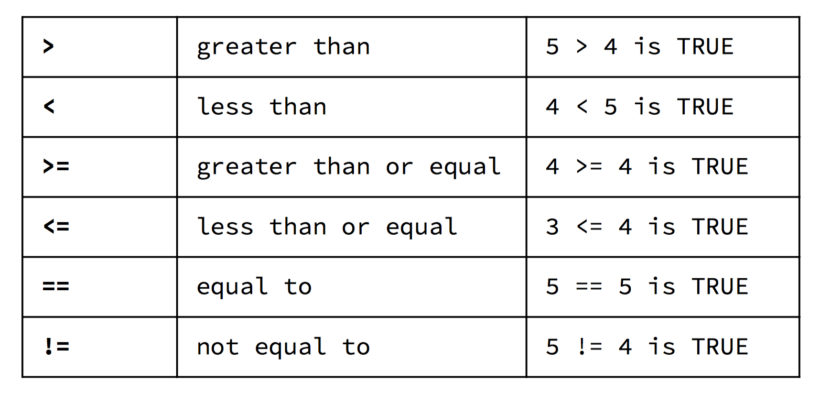
Relational Operators

Slide 9
Logical Operators
&& (AND) returns true if and only if both operands are true
If(temp > 0 && temp < 100) : water is in liquid state
|| (OR) returns true if one or both operands are true
If(temp < 0 || temp > 100) : water is not in liquid state
! (NOT) returns true if operand is false and false if operand is true
if(!passed) : failed

Slide 10
Boolean Data Type
bool passed = true; used to store either true or false values
In C++
int(true) equates to 1
int(false) equates to 0
Any non-zero number evaluates to true.
if(x == 5) compares and returns bool variable true or false
if(x = 5) assigns value 5 to x and since the value is nonzero it evaluates to true.

Slide 11
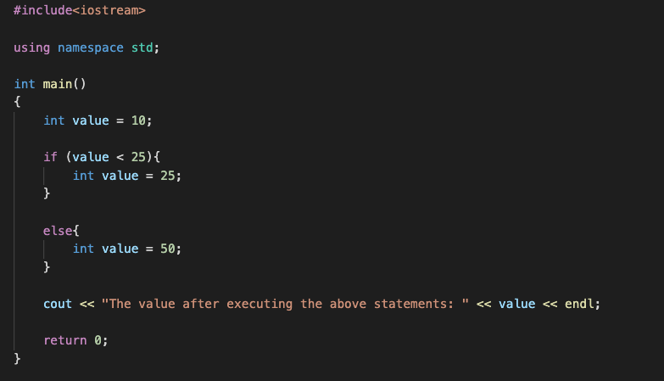
Variable Scope
Variables have scope along with the datatype.
Scope defines the extent to which you can access a variable in your code.

Slide 12
Home Work!

